Slide 1
MATH221
Mathematics for Computer Science
Unit 8
Elementary Number Theory
1

Slide 2
OBJECTIVES
Understand the definition of divisibility.
Understand apply the Quotient-Remainder Theorem.
Understand and be able to find the Greatest Common Divisor.
Understand and apply the Euclidean Algorithm.
Understand the concept of the Fundamental Theorem of Arithmetic.
2

Slide 3
Divisibility
If n and d are integers and d ≠ 0, then n is divisible by d if and only if
n = d × k for some k ∈ ℤ.
We write d | n and say that d divides n (n is divisible by d).
In logic notation, the definition of divisibility is written
d | n ⇔ ∃k ∈ ℤ, n = dk.
3

Slide 4
Divisibility
Alternatively, if
d | n ⇔ ∃k ∈ ℤ, n = dk.
We say that
n is a multiple of d, or
d is a factor of n, or
d is a divisor of n, or
d divides n.
4

Slide 5
Discussion:
1. Is -16 a divisor of 32?
Yes.
32 = -16 × -2.
2. If l ∈ ℤ and l ≠ 0, does l | 0?
Yes.
0 = l × k for some k ∈ ℤ.
5

Slide 6
Discussion:
3. Find all values of a ∈ ℤ such that a | 1.
a | 1 ⇔ ∃k ∈ ℤ, 1 = ak.
For a = 1 and k = 1, ak = 1.
For a = -1 and k = -1, ak = 1.
Therefore, a = -1 or 1.
6

Slide 7
Discussion:
4. What is the relationship between a and b if a | b, and b | a, a, b ∈ ℤ?
Now, a | b ⇔ ∃k ∈ ℤ, b = ak (1)
b | a ⇔ ∃l ∈ ℤ, a = bl (2)
Substitute (2) into (1),
b = (bl)k
Divide both sides by b,
1 = lk
Since l, k ∈ ℤ, ⇒ l = k = 1. or l = k = -1.
Hence, a = ± b.
7

Slide 8
Discussion:
5. If a , b ∈ ℤ, is 3a + 3b divisible by 3?
Now, 3a + 3b = 3(a + b)
= 3s
where s = a + b and s ∈ ℤ.
Hence, 3 | 3a + 3b, that is, 3a + 3b is divisible by 3.
8

Slide 9
Discussion:
6. If a , b, c, x, y ∈ ℤ. If b | a and b | c, does b | (ax + cy)? Why?
Now, b | a ⇔ ∃k ∈ ℤ, a = bk (1)
b | c ⇔ ∃l ∈ ℤ, c = bl (2)
(1) × x, ax = bkx (3)
(2) × y, cy = bly (4)
(3) + (4), ax + cy = bkx + bly
= b(kx + ly)
= bm where m = kx + ly, m ∈ ℤ.
Hence, b | (ax + cy).
9

Slide 10
Discussion:
7. If a, b ∈ ℕ, is it true that a | b implies a ≤ b?
Now, a | b ⇒ ∃k ∈ ℤ, b = ak.
Since a , b ≥ 1, so k ≥ 1.
Multiply both sides of the inequality by a,
ka ≥ 1a.
Hence, b ≥ a.
That is, a ≤ b
Therefore, if a , b ∈ ℕ, it is true that a | b implies a ≤ b.
10

Slide 11
Theorem - Transitivity of Divisibility
For all integers a, b and c, if a | b and b | c, then a | c.
Note: After going through the details of the proof for this theorem, for the remaining theorems, lemma, etc., we shall focus on the application. For their proofs, please refer to the supplementary notes.
11

Slide 12
Transitivity of Divisibility: Proof
We know that
a | b ⇒ ∃k ∈ ℤ, b = ak (1)
b | c ⇒ ∃l ∈ ℤ, c = bl (2)
Show that a | c, that is, find m ∈ ℤ such that c = ma.
Now, c = bl by (2)
= (ak)l by (1)
= (kl)a by associativity and commutativity
Let m = kl, then m ∈ ℤ (since × is a closed operation on ℤ). Therefore, c = ma and so a | c.
12

Slide 13
Theorem - Divisible by a Prime
Theorem:
Every integer n ≥ 2 is divisible by some prime number.
13
Notes:
k is divisible by some prime number.
Since 2<r<k, r is divisible by some prime number, ie. p|r.
Since p|r and r|(k+1), so p|(k+1).

Slide 14
Theorem – Infinite Primes
Theorem:
There are infinitely many primes.
14

Slide 15
The Quotient-Remainder Theorem
If n ∈ ℤ and d ∈ ℕ, then there exist unique integers q and r such that
n = dq + r and 0 ≤ r < d.
The theorem says that when we divide any integer n by any positive integer d, there will be a unique quotient q and remainder r satisfying 0 ≤ r < d.
15

Slide 16
The Quotient-Remainder Theorem: Note
Note that the theorem makes two assertions:
1. Existence: There exists q, r ∈ ℤ such that
n = dq + r and 0 ≤ r < d.
2. Uniqueness: There is only one pair of values of q and r with these properties.
16

Slide 17
The Quotient-Remainder Theorem: Note
The Quotient-Remainder Theorem says that when we divide any integer n by any positive integer d, there will be a quotient q and a remainder r, where 0 ≤ r < d.
Example.
Let n = 11, d = 4.
Then we have 11 = 4 × 2 + 3;
That is, q = 2 and r = 3.
17

Slide 18
Exercise:
Find values for q, r ∈ ℤ such that n = d × q + r, 0 ≤ r < d, for the following.
(i) n = 54, d = 4
For positive n, a positive quotient q is multiplied to the divisor d to obtain a number slightly smaller than n.
Then the nonnegative integer r is then added to the product (d × q) to make it equal to n.
That is,
54 = 4 × 13 + 2.
Hence, q = 13, r = 2.
18

Slide 19
Exercise:
(ii) n = -54, d = 4
For negative n, a negative quotient q is multiplied to the divisor d to obtain a number slightly smaller than n (ie. more negative than n).
Then the nonnegative integer r is then added to the product (d × q) to make it equal to n.
That is,
-54 = 4 × -14 + 2.
Hence, q = -14, r = 2.
19

Slide 20
Exercise:
(iii) n = 54, d = 70
Now, 54 = 70 × 0 + 54.
Hence, q = 0, r = 54.
Can you find a second set of q and r (r < d)?
No. The Quotient-Remainder Theorem says that q and r are unique, that is, there is only one solution for q and r in the previous exercise.
20

Slide 21
Theorem – Classification of Integer
Theorem:
Every Integer is either Odd or Even.
21

Slide 22
Greatest Common Divisor
Let a, b ∈ ℤ with a ≠ 0 or b ≠ 0. A natural number c is said to be the greatest common divisor (gcd) of a and b if and only if
(i) c | a and c | b; and
(ii) if d | a and d | b for some d ∈ ℕ, then d | c.
We write gcd(a, b) = c.
22

Slide 23
Exercise:
1. Evaluate gcd(18, 12), gcd(18, -12), gcd(-18, 12)
and gcd(-18, -12).
Common divisors: -6, -3, -2, -1, 1, 2, 3, 6
For all the above the greatest common divisor is 6.
2. What can you say about gcd(a, b); gcd (a, -b); gcd(-a, b); gcd(-a, -b)?
All have the same value.
3. Evaluate gcd(7, 11).
1.
23

Slide 24
Exercise:
4. For a, b ∈ ℤ where not both are zero, does gcd(a, b) always exist? Is it unique?
Yes, it will always exist.
Yes.
For example, gcd(4, 0) = 4 and gcd(0, -3) = 3.
5. gcd(0, 0) is not allowed. Why? What would it be if it were found in the same way as for other pairs of numbers?
Every integer divides 0 and there is no largest integer.
So there is no largest common divisor. Hence, the definition of GCD excludes this case.
24

Slide 25
Exercise:
6. Evaluate gcd(2772, 2310).
Use the Euclidean Algorithm that we will learn later in this unit.
25

Slide 26
Lemmas
Lemma 1:
If r is a positive integer, then gcd(r, 0) = r.
Lemma 2:
If a, b ∈ ℤ with b ≥ 1, and if q and r are integers such that
a = b × q + r, then
gcd(a, b) = gcd(b, r).
26

Slide 27
The Euclidean Algorithm
The Euclidean Algorithm is a process for finding the greatest common divisor between two integers.
It is described as follows:
1. Let A and B be integers with A > B ≥ 0.
2. If B = 0, then gcd(A, B) = A.
If B > 0, then the quotient-remainder theorem can be used to divide A by B to obtain a quotient q and a remainder r:
A = Bq + r where 0 ≤ r < B.
Hence, gcd(A, B) = gcd(B, r).
3. Repeat the process starting at (2), but use B instead of A and r instead of B.
The repetitions are guaranteed to terminate eventually with r = 0.
27

Slide 28
The Euclidean Algorithm: Example
Evaluate gcd(2772, 2310).
Step 1: Divide 2772 by 2310:
2772 = 2310 × 1 + 462
gcd(2772, 2310) = gcd(2310, 462)
Step 2: Divide 2310 by 462:
2310 = 462 × 5 + 0
gcd(2310, 462) = gcd(462, 0)
Since gcd(462, 0) = 462, hence, gcd(2772, 2310) = 462.
28

Slide 29
Note for Answering QUIZ Questions: Expressing Steps in Applying Euclidean Algorithm
In using Euclidean Algorithm to find gcd(x, y), we will express gcd(x, y) = gcd(x₁, y₁) = gcd(x₂, y₂) =….=gcd(x_{n}, 0), what is the value of n for gcd(2772, 2310)?
Evaluate gcd(2772, 2310).
Step 1: Divide 2772 by 2310:
2772 = 2310 × 1 + 462
gcd(2772, 2310) = gcd(2310, 462)
Step 2: Divide 2310 by 462:
2310 = 462 × 5 + 0
gcd(2310, 462) = gcd(462, 0)
Since gcd(462, 0) = 462, hence, gcd(2772, 2310) = 462
Hence, gcd(2772, 2310) = gcd(2310, 462) = gcd(462, 0).
In this calculation, x₁ = 2310, y₁ =462; x₂ = 462, y₂ = 0
Hence, n =2
29

Slide 30
Relatively Prime
If a, b ∈ ℤ and gcd(a, b) = 1, then a and b are relatively prime.
Example:
Since gcd(17, 9) = 1.
Hence, we say that 17 and 9 are relatively prime.
30

Slide 31
Theorem on Linear Combination of gcd
If a, b ∈ ℤ and not both equal zero, then gcd(a, b) exists and there exist m, n ∈ ℤ such that gcd(a, b) = ma + nb.
31

Slide 32
Theorem on Linear Combination of gcd: Notes
1. The theorem says two things.
(i) gcd(a, b) always exists as long as both a and b are not both zero; and
(ii) gcd(a, b) can be written as a linear combination of a and b.
2. The proof to this theorem is similar to that of the Quotient-Remainder Theorem. The proof is not examinable.
32

Slide 33
How to find Linear Combination of gcd?
1. Use Euclidean Algorithm to find the gcd step-by-step and write down the expression resulted from applying quotient-remainder theorem in each step.
2. Work backwards systematically as shown in the next slide to get the linear combination of gcd.
33

Slide 34
Find Linear Combination of gcd: Example
Finding linear combination of gcd for 7854 and 2772.
Using Euclidean Algo, we compute gcd(7854, 2772) as follows:
7854 = 2772 × 2 + 2310 ------- (1)
2772 = 2310 × 1 + 462 -------(2)
2310 = 462 × 5 + 0
Hence, gcd(7854, 2772) = gcd(462, 0) = 462
(1) ⇒ 2310 = 7854 - 2772 × 2 --------(3)
(2) ⇒ 462 = 2772 - 2310 × 1 --------(4)
Work backwards from (4), we get:
  462 = 2772 - 2310 × 1 (from (4))
  = 2772 – (7854 - 2772 × 2) ×1 (from (3))
  = (-1) × 7854 + 3 × 2772
Hence, the linear combination of gcd for 7854 and 2772 is:
  462 = (-1) × 7854 + 3 × 2772
34

Slide 35
Corollaries
Corollary 1:
If a, b are relatively prime, then ∃m, n ∈ ℤ such that
1 = ma + nb.
Corollary 2:
Let a, b, c ∈ ℤ.
If gcd(a, b) = 1 and a | bc, then a | c.
35

Slide 36
Euclid’s Lemma
Let p be a prime and a, b ∈ N. If p | ab, then p | a or p | b.
36

Slide 37
Exercise:
1. Write the following numbers in terms of their prime factors.
32
= 16 × 2
= 8 × 2 × 2
= 4 × 2 × 2 × 2
= 2 × 2 × 2 × 2 × 2
37

Slide 38
Exercise:
2. Write the following numbers in terms of their prime factors.
924
= 462 × 2
= 231 × 2 × 2
= 77 × 3 × 2 × 2
= 11 × 7 × 3 × 2 × 2
38

Slide 39
Exercise:
3. Are these factorization unique? How do you know?
Yes.
The Fundamental Theorem of Arithmetic states that
each integer greater than 1 can be decomposed into prime factors – and this decomposition is the only one.
4. Can you express EVERY natural number as a product of primes?
No, since 1 is not prime.
39

Slide 40
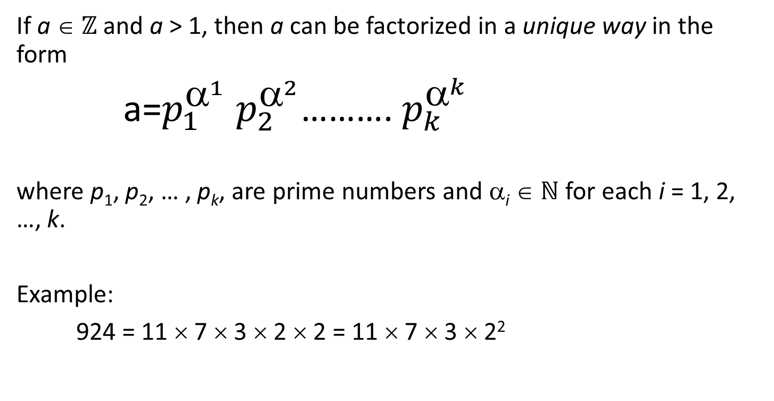
The Fundamental Theorem of Arithmetic
If a ∈ ℤ and a > 1, then a can be factorized in a unique way in the form
a=$p_{1}^{^{1}}$ $p_{2}^{^{2}}$………. $p_{k}^{^{k}}$
where p₁, p₂, … , p_{k}, are prime numbers and α_{i} ∈ ℕ for each i = 1, 2, …, k.
Example:
924 = 11 × 7 × 3 × 2 × 2 = 11 × 7 × 3 × 2²
40

Slide 41
Finding Prime Numbers
The easiest method to find prime numbers up to n is to use the Sieve of Eratosthenes algorithm.
41

Slide 42
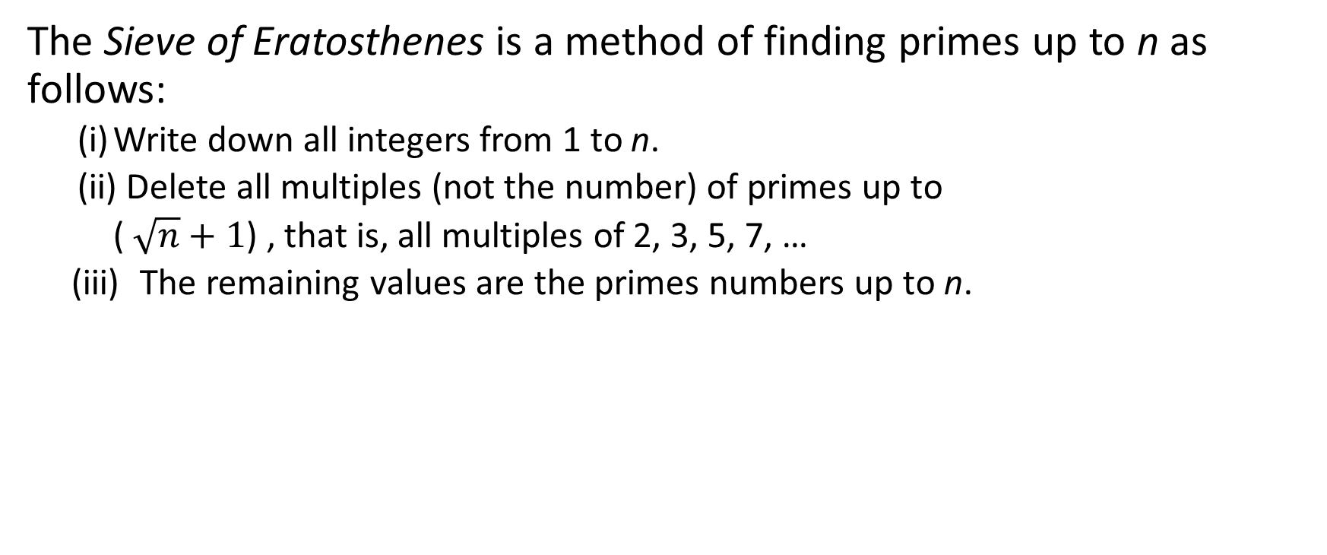
Sieve of Eratosthenes Algorithm
The Sieve of Eratosthenes is a method of finding primes up to n as follows:
  (i) Write down all integers from 1 to n.
  (ii) Delete all multiples (not the number) of primes up to
  ( $\sqrt{n}+1$) , that is, all multiples of 2, 3, 5, 7, …
  (iii) The remaining values are the primes numbers up to n.
42

Slide 43
Exercise: Find all primes between 1 and 100.
X
X
X
X
X
1 2 3 4 5 6 7 8 9 10
11 12 13 14 15 16 17 18 19 20
21 22 23 24 25 26 27 28 29 30
31 32 33 34 35 36 37 38 39 40
41 42 43 44 45 46 47 48 49 50
51 52 53 54 55 56 57 58 59 60
61 62 63 64 65 66 67 68 69 70
71 72 73 74 75 76 77 78 79 80
81 82 83 84 85 86 87 88 89 90
91 92 93 94 95 96 97 98 99 100
X
X
X
X
X
X
X
X
X
X
X
X
X
X
X
X
X
X
X
X
X
X
X
X
43

Slide 44
Least Common Multiples
Let a, b ∈ Z be two nonzero integers. The least common multiple of a and b, denoted lcm(a, b), is the positive number c with the properties:
  c is a common multiple of a and b; that is, a | c and b | c .
  If d is a common multiple of a and b, then c ≤ d .
Examples: lcm(18, 12) = 36
lcm(18, 15) = 90
44

Slide 45
Least Common Multiples
We can use prime factorisations to calculate the lcm. Suppose
a = p^{α1} p^{α2} . . . p^{αk} and b = p^{β1} p^{β2} . . . p^{βk}
1 2 k 1 2 k
Then
lcm(a, b) =a = p₁^{γ1} p₂^{γ2} . . . p_{k}^{γk} where
where γ_{i =} α_{i} , if α_{i} ≥ β_{i}
γ_{i =} β_{i} , otherwise
45

Slide 46
Calculating Least Common Multiples: Examples
Given that 3220 = 2² × 5 × 7 × 23 and 1155 = 3 × 5 × 7 × 11, we have
lcm(3220, 1155) = 2² × 3 × 5 × 7 × 11 × 23
Given that 35100 = 2² × 3³ × 5² × 13 and 6975 = 3² × 5² × 31, we have
lcm(35100, 6975) = 2² × 3³ × 5² × 13 × 31
46

Slide 47
End of Unit 8
47

